Slide 1

Smart Phone Theft

Slide 2


Slide 3
London is the epicentre for phone theft.
There was a 33% increase in reported mobile phone theft from the person in the year to January 2024, and over 1/3 of offences took place in Westminster.

Slide 4

Locked Handset
A locked handset could have a street value of a few hundred pounds if it’s a recent model.
But if unlocked, it could generate multiple thousands of pounds if criminals can get into the settings, change passwords and compromise other security features.

Slide 5

Predatory Behaviour
“It’s predatory behaviour,” says FT article. “They are like lions stalking prey, and unfortunately, women make easier targets than men.
It’s very unlikely a woman will try to punch you, and a man has more strength to grab someone.”
The cleaner the snatch, the less likely it is that a screen lock will be activated.

Slide 6
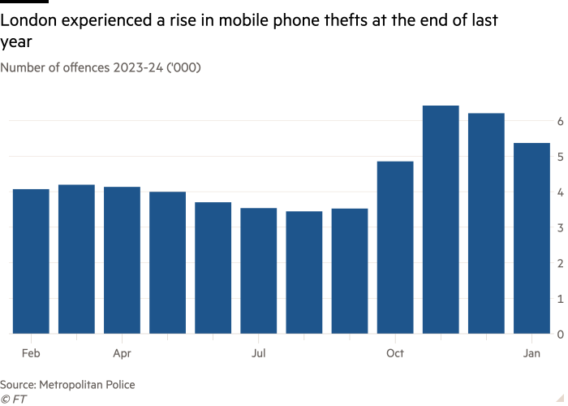

Slide 7

Criminals can “shoulder surf”
Criminals can “shoulder surf” in crowded places, or even hack into CCTV — then steal their phones to order.
Multiple bank and credit cards were stored in his smartphone’s digital wallet, and criminals wasted no time purchasing high-value electrical items, spending slightly less than £10,000 on each credit card to avoid triggering daily spending limits.

Slide 8
Phone theft in Dublin
Tech executive James O’Sullivan was drinking with friends in a bar in Dublin last autumn when he realised his phone had been pickpocketed.
Marking a phone as “lost” by logging into your account online via another device will disable its digital wallet, but O’Sullivan was unable to do this as criminals had reset his password.
“Crypto and banking apps on your phone are very well protected from someone who hasn’t got your phone, but all of the two-factor security codes, notifications and emails to reset passwords are delivered on to the same device,” he says.

Slide 9

Personal loans
Criminals can even apply for personal loans within banking apps

Slide 10

Losses
Losses from mobile banking fraud increased by 17 per cent to £18.7mn in the first six months of 2023, the highest recorded total, according to banking trade body UK Finance.

Slide 11

GSM Standard
Because UK handsets operate on the GSM standard, barred handsets can be shipped overseas and used on foreign networks with a new Sim card.

Slide 12

Organised Crime Gangs
“The suspicion is that there’s organised crime gangs behind this who are aggregating the stolen phones and re-exporting them around the world in shipping containers,” he says.
Within the UK, stolen handsets can be broken down for spare parts (screens and camera lenses are very valuable)

Slide 13
What can you do?
Use a smartwatch to tap and pay on public transport and receive notifications from mapping and taxi apps, meaning your phone can stay hidden in a bag.

Slide 14
Apple IOS
Apple’s latest iOS update rolled out Stolen Device Protection which helps prevent thieves who know your passcode from making critical changes, such as changing your Apple ID password.
If your iPhone is away from a familiar location such as your home/office, a delay of 1 hour will apply before changes can be made.
Plus, biometric authentication will be needed to access stored passwords and credit cards with no passcode fallback.
However, you need to activate this and have location services switched on for it to work.

Slide 15
Android
Most Android phones come with a built-in feature that allows you to lock individual apps with a PIN.
This will create more friction for criminals — but could also make your phone less convenient to use.
Locking criminals out by setting up a separate, physical security key such as YubiKey to provide two-factor authentication codes (which are not sent to your phone) adds an extra layer of protection.

Slide 16
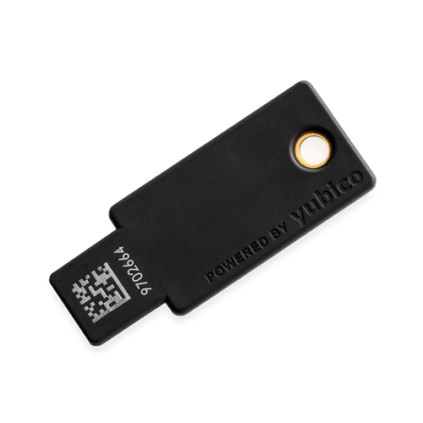
https://www.yubico.com/

Slide 17
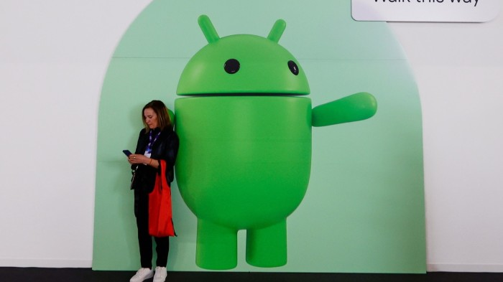

Slide 18
Android smartphones
Google said it would use AI to detect when Android smartphones have been snatched and quickly lock the screen, as technology groups move to protect sensitive data amid reports of rising mobile phone theft.
E.g., detects “a common motion associated with theft” — such as if a thief takes a phone from an owner’s hand and attempts to run, cycle, or drive away with it.
The feature will be rolled out later this year to devices running later Android operating systems.

